Slide 1
Astro 331 Lesson 8
Launch Systems & Mission Operations
Supp Crs Mtl, SMAD Ch 8

Slide 2
Lesson Objectives
Describe the objective of a launch vehicle and why staging is required
Describe the purpose of a launch vehicle’s payload fairing (PLF)
Describe what is meant by maximum dynamic pressure (max-q) and why it is important for launch vehicles
Describe the loading conditions during launch that drive spacecraft structural design
Understand how launch site latitude and allowable azimuths impact which orbits launch vehicles can insert into
Describe the functions of space mission operations
Describe different spacecraft functions that can be automated and some of the advantages and disadvantages of automation
Describe contingency planning in operations and what an anomaly response team does

Slide 3
LAUNCH SYSTEMS

Slide 4
Launch Systems Intro
Objective: to accelerate and positon a mass (the payload, usually a satellite or spacecraft) up to the velocity and location required for the payload’s trajectory
Staging: using multiple propulsive units which separate and are discarded after use to get to orbit
Why do we do staging?
B/c of the performance limitations on chemical propellants as well as the current state of the art in materials engineering and structural design, it is not practical to send a launch vehicle to orbit using a single propulsion system.
Two types: series and parallel

Slide 5
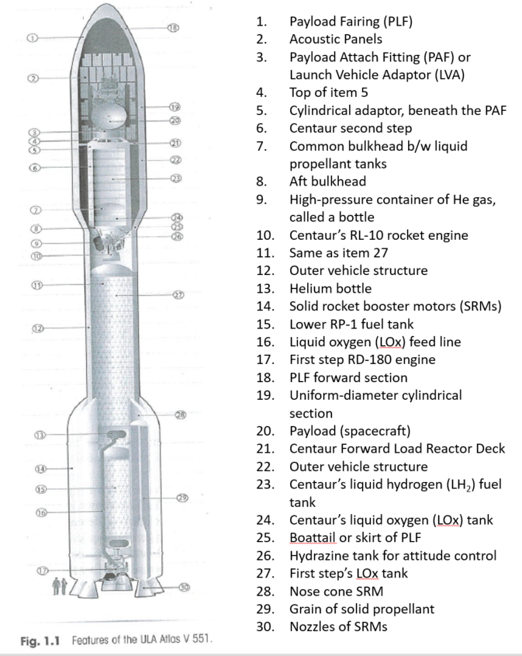

Slide 6
Payload Fairing (PLF)
Payload Fairing (PLF) protects the payload from aerodynamic and heating loads as the LV climbs out of the atmosphere, keeps FOD away from payload, and serves as a container with a specially conditioned atmosphere to meet the payload’s thermal requirements
PLF is jettisoned once environment is safe for payload (above atmosphere)
Shock associated with the PLF jettison can be among the most significant transient design environment that a spacecraft must endure

Slide 7
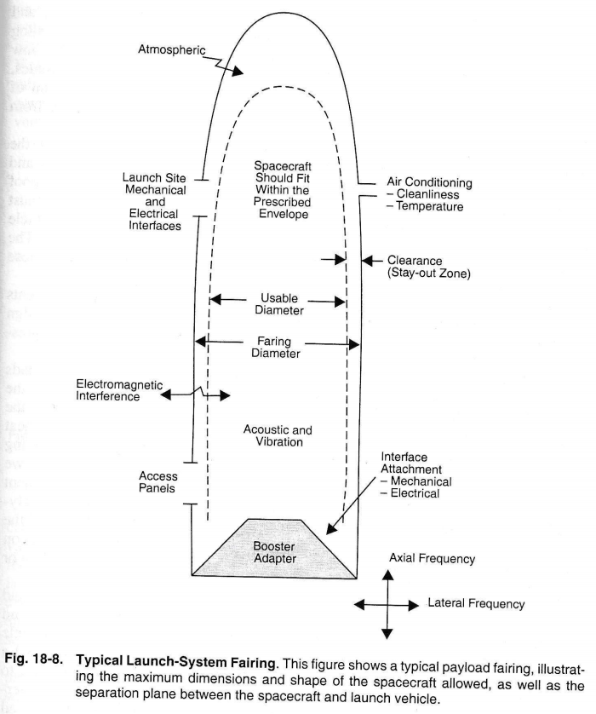

Slide 8
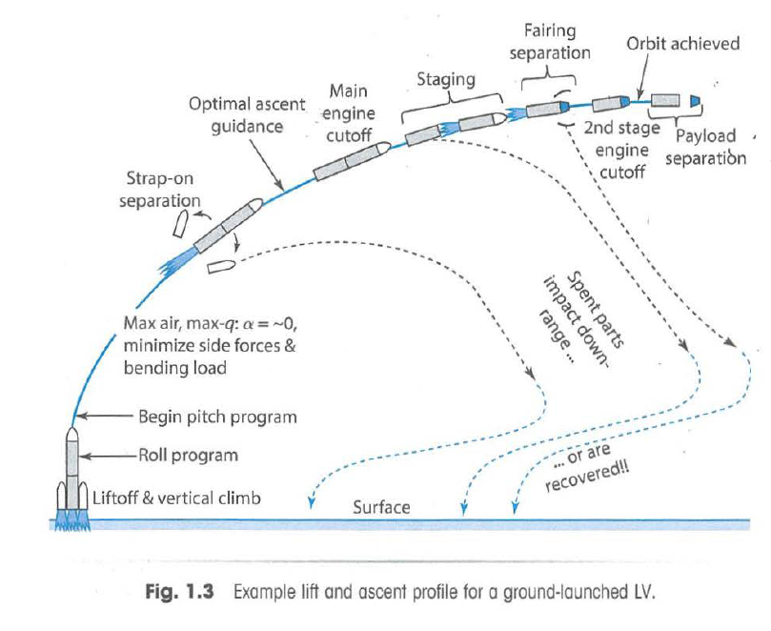

Slide 9
Maximum Dynamic Pressure
Max-Q (maximum dynamic pressure): point during ascent at which aerodynamic loads on vehicle are at highest
Sets maximum bending load values for vehicle (and payload)
Usually occurs just after vehicle passes Mach 1
Buffeting loads are also highest near Max-Q
Common for motors to be throttled back near Max-Q to reduce vehicle acceleration and loading
After Max-Q, the atmospheric density decreases faster than the vehicle’s speed increases, which causes the dynamic pressure to decrease

Slide 10
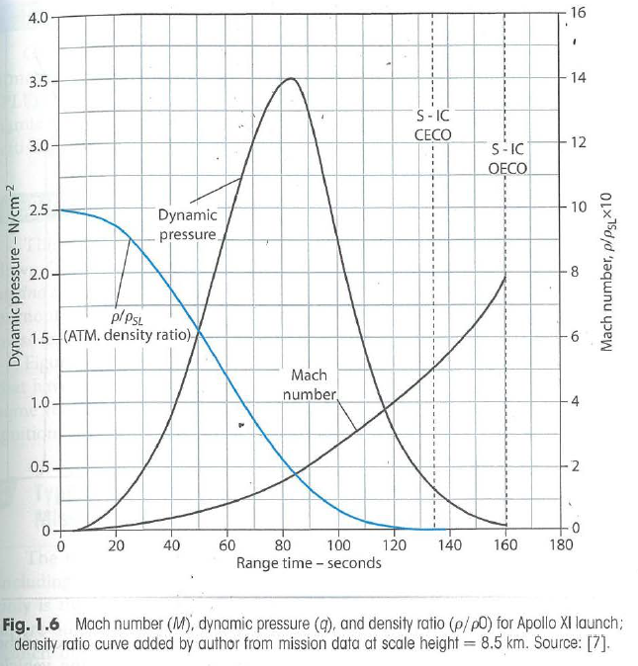

Slide 11
Loading Conditions during Launch & Ascent
Axial and lateral loading during liftoff
Vibrations during liftoff
Acoustic loading due to noise during liftoff & ascent
Pyrotechnic shock due to separation events

Slide 12
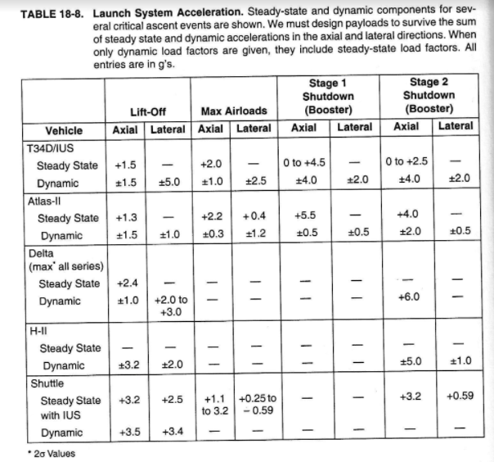

Slide 13
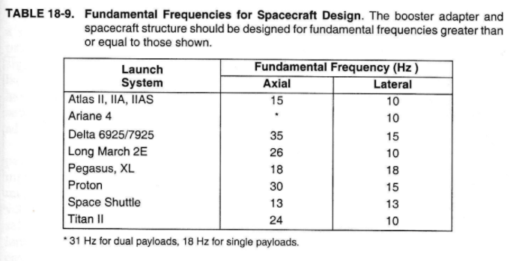

Slide 14
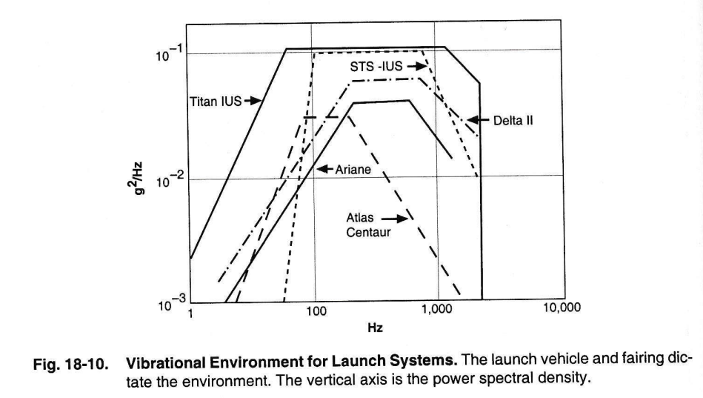

Slide 15
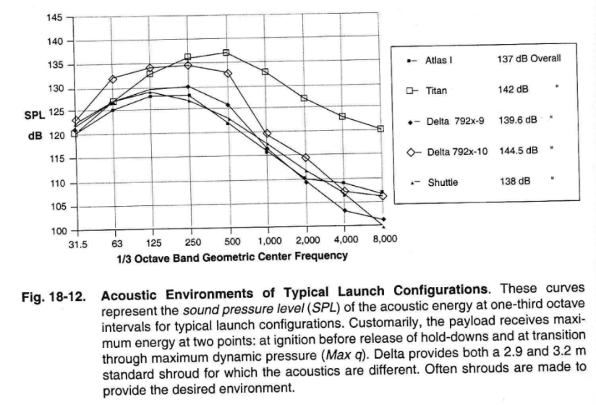

Slide 16
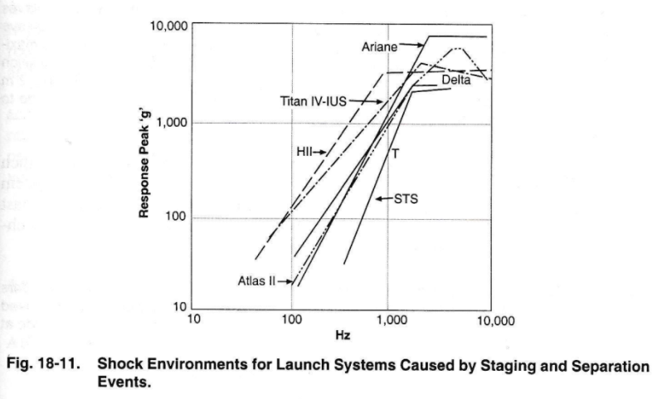

Slide 17
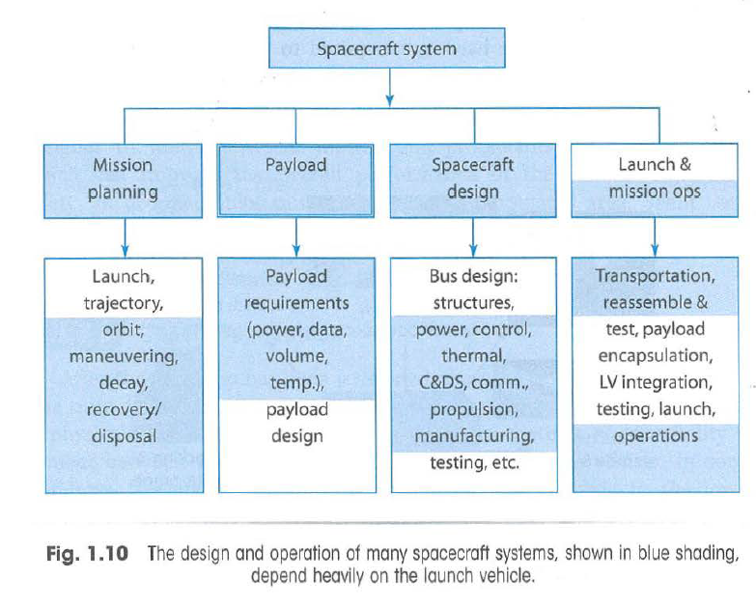

Slide 18
Launch Limitations
Recall that the latitude of the launch site must be less than or equal to the inclination of the orbit
Recall also that each launch site has allowable launch azimuths that must be met
Also need to consider transportation of spacecraft to launch site and weather at launch site during expected launch timeframe

Slide 19
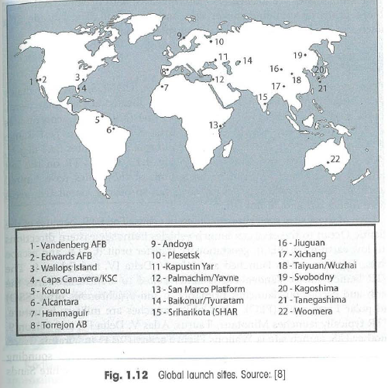

Slide 20
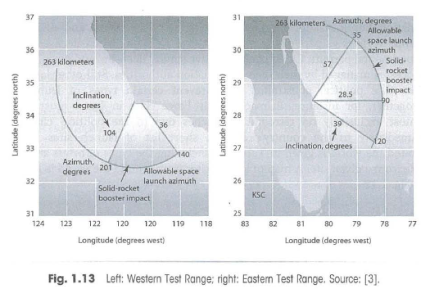

Slide 21
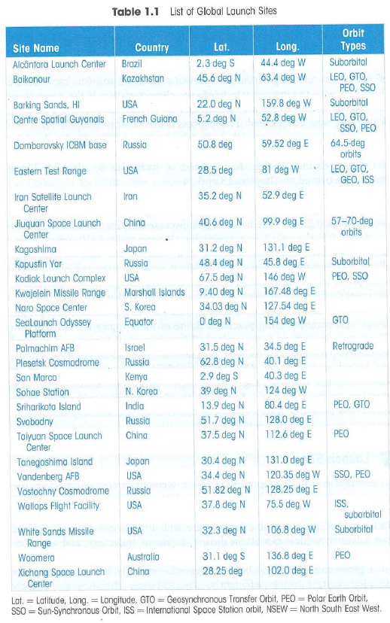

Slide 22
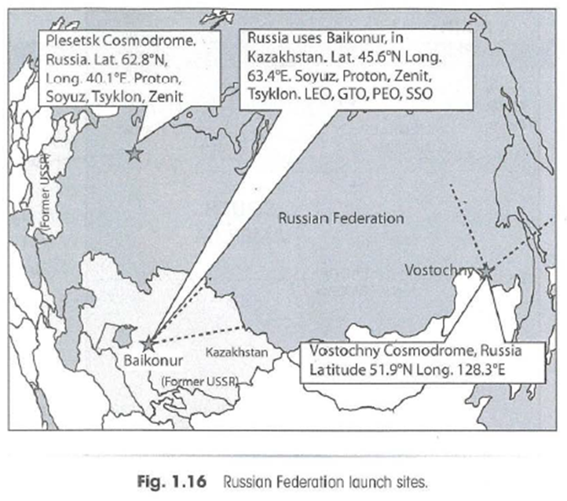

Slide 23
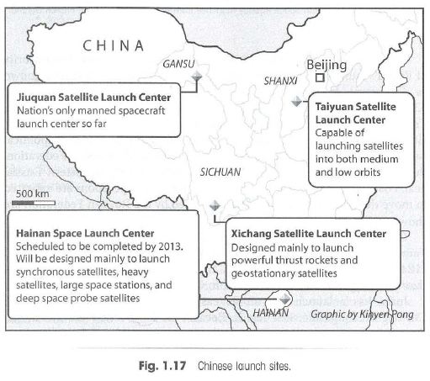

Slide 24
MISSION OPERATIONS

Slide 25
Space Mission Operations
Objective: Execute the mission and preserve the health and safety of the vehicle
Functions include:
Mission Planning: deciding what to do and when
Activity Planning & Development: creating operational scenarios and developing command loads
Mission Control: managing daily activities
Data Transport and Delivery: establishing communication links and managing data flow
Navigation and Orbit Control: determining where the spacecraft is and planning maneuvers
Spacecraft Ops: managing the spacecraft bus
Payload Ops: managing the spacecraft payload

Slide 26
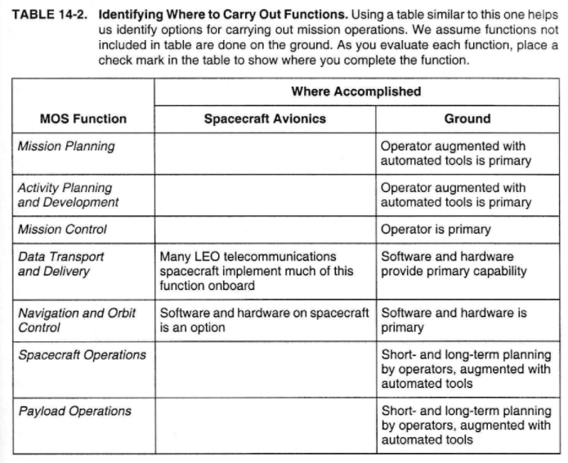

Slide 27
Mission Planning
Operations Plan: details the operations organization, processes and procedures to be followed by the operations team, the software tools that support them, and the interfaces between other teams (ie, spacecraft development team)
Best way to train operators it to involve them in the development and testing phases
Mission Plan: documents the planned spacecraft activities during the mission

Slide 28
Automation in Operations (1/2)
Many functions in space operations can be automated, either on-board the spacecraft or on the ground
Monitoring alarms
Managing spacecraft resources
Analyzing performance and trends
Onboard navigation & orbit control
Adaptively planning activities
Processing payload data
Detecting faults, safing the vehicle
Constraint checking commands
Filtering/archiving data

Slide 29
Automation in Operations (2/2)
Advantages | Disadvantages
Reduced staffing = reduced operations cost | Potential to miss unexpected signatures
Reduced changes for operator error | Potential for fault response to be improper
Reduced response time to fault responses | Potential to misuse spacecraft resources
Potential to reduce data transmitted from spacecraft to ground | Potential to damage spacecraft
*Decision on how much and where to automate depends on risk posture, mission objectives and budget

Slide 30
Contingency Planning (1/2)
Definition: Identifying potential problems and a plan of action to mitigate impact if problem occurs
Not every problem can be anticipated, but the process of developing a contingency plan helps prepare the team to deal with problems when they occur
Prior to flight, identify anomaly response team – should have members of operations and development teams (and possibly other teams)
Prior to flight, the design and operations teams should work together to brainstorm every conceivable potential anomaly and for each case, develop operational responses
During flight, have development team members support operations

Slide 31
Contingency Planning (2/2)
In case of a failure:
Determine how much time is available before a decision is required
Make a timeline of events and include everything that is known
Give all team members all known facts and check every theory against them
Have multiple teams: some should investigate timeline replanning, others should work on hardware/software repair or workarounds
Make sure any deviation from the norm is explained—remember, the wrong conclusion is prologue to the next failure
Do not arrive at a conclusion too rapidly
Know when to stop trying to force-fit a scenario

